Slide 1







Anomaly Detection System
By Sai Nikhil Naru and Yasin Alam
MEETING IS STARTING SOON...
JOIN THE DISCUSSION!
FOLLOW US!
@tidaltamu

Slide 2
t i d a l t a m u
TETHERED INFORMATICS & DATA ANALYTICS LAB

Slide 3
Today’s Lecture Topics
Problem formulation
Gaussian Distribution
Anomaly Detection vs. Supervised Learning
Developing and Evaluating an Anomaly Detection System
Choosing What Features to Use
Outlier detection
Autoencoding

Slide 4
Reminders
We are only providing some of the potential functions of each library we examine
In order to get better at coding, you need to constantly be using it
To learn more, use your browser and search for specific thing
If I wanted to find how to export a pandas dataframe to a csv
Google “export dataframe to csv file”

Slide 5
Today’s Lecture
Introduction to Gaussian Distribution, Anomaly Detection, and Autoencoding

Slide 6
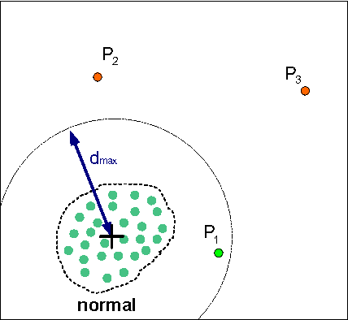
Problem formulation
Want to find a way to detect anomalies
How do we know what’s normal?
What do outlier values look like?
Build a model giving p(x)
If p(x) < epsilon:
Flag as an anomaly

Slide 7
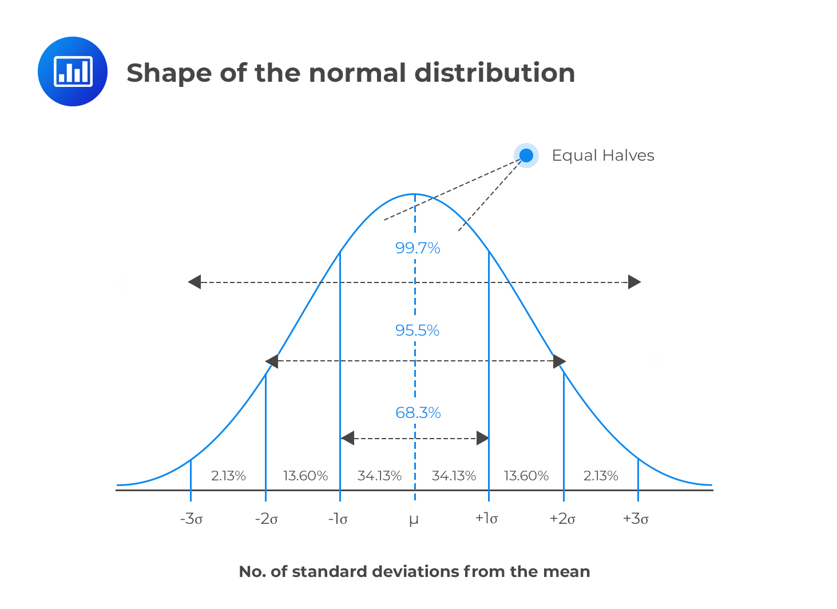
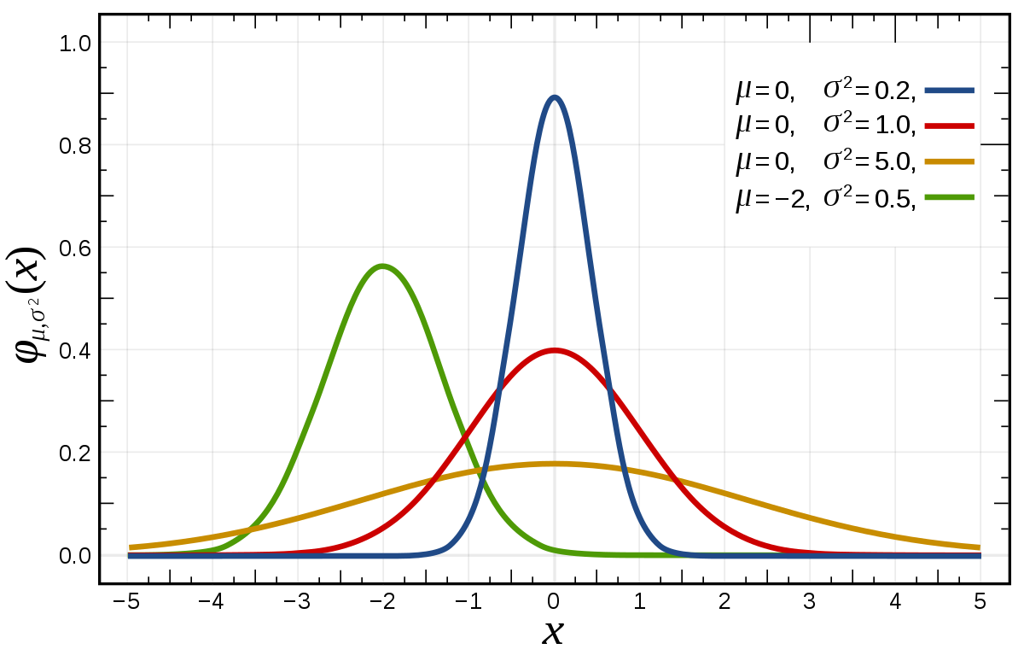
Gaussian Distribution

Slide 8

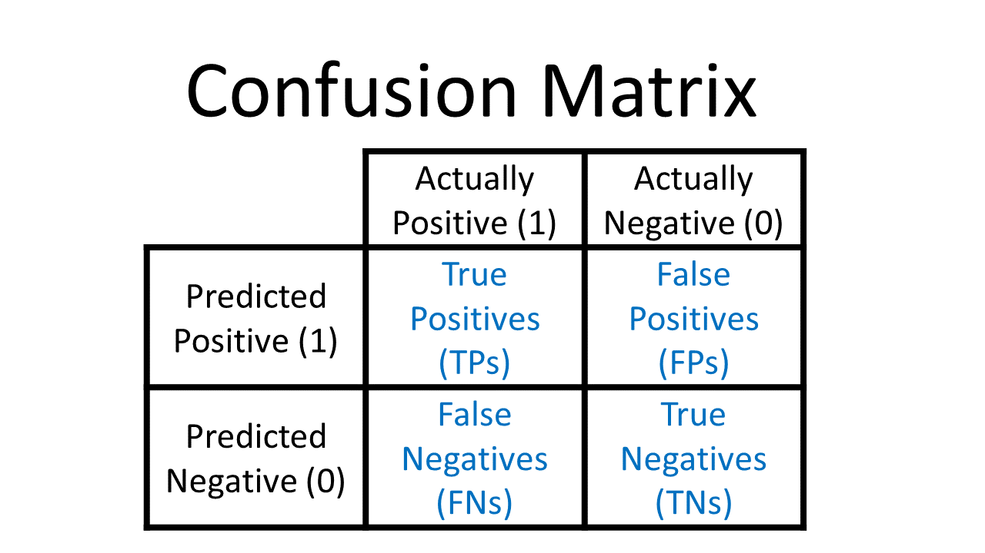
Developing and Evaluating an Anomaly Detection System
Engine Example
10000 good/normal engines
20 flawed/anomalous engines
Training set (fitting good data):
6000 good engines
Cross Validation:
2000 good engines (y=0), 10 bad engines (y=1)
Test:
2000 good engines, 10 bad engines
Evaluation:
Confusion matrix (TP, FP, …)
Precision/Recall
Can use CV to choose parameter epsilon (𝜀)

Slide 9
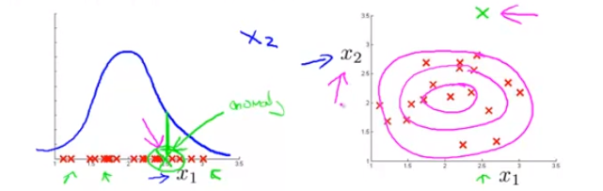
Choosing What Features to Use
Make sure data looks Gaussian
Use a Histogram!
If not, transform the data to look Gaussian
log(x), log(x+c), √(x)
Analyze the data for features that detect the errors
Or create your own!

Slide 10
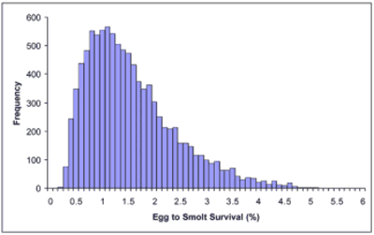
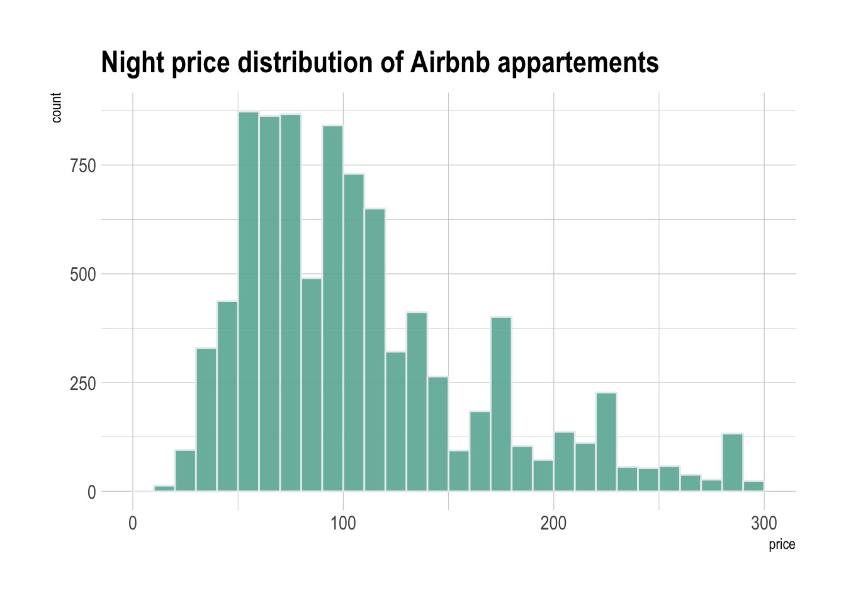
Choosing What Features to Use
Notes:
Examples of data we can transform to be Gaussian

Slide 11
Anomaly Detection vs. Supervised Learning
In anomaly detection, it is unsupervised as you don’t use any labelled values. What you do is you train using only the non outlier data. You then select epsilon values and evaluate with a numerical metric.
In supervised learning, the labelled data when you pass these values as you train the model so that it learns the good parameters from the bad ones. Supervised learning makes sense if you know typically what 'bad' values are. If you only know what is 'normal’ but your 'bad' value can really be very different every time then this is a good case for anomaly detection. Better to use if you have lots of anomaly samples.

Slide 12
Outlier detection
Outlier is a data point that's far away from the mean or median in a distribution. Anomaly detection refers to the problem of ending anomalies in data. While anomaly is a general term, such as outliers often used in different application categories.
Four Outlier Detection Techniques
Numeric Outlier
Z-Score
DBSCAN
Isolation Forest

Slide 13
Autoencoding
Autoencoders are an unsupervised learning technique in which we leverage neural networks for the task of representation learning (Representation learning has emerged as a way to extract features from unlabeled data by training a neural network on a secondary, supervised learning task) .
The ideal autoencoder model balances the following:
Sensitive to the inputs enough to accurately build a reconstruction.
Insensitive enough to the inputs that the model doesn't simply memorize or overfit the training data.

Slide 14
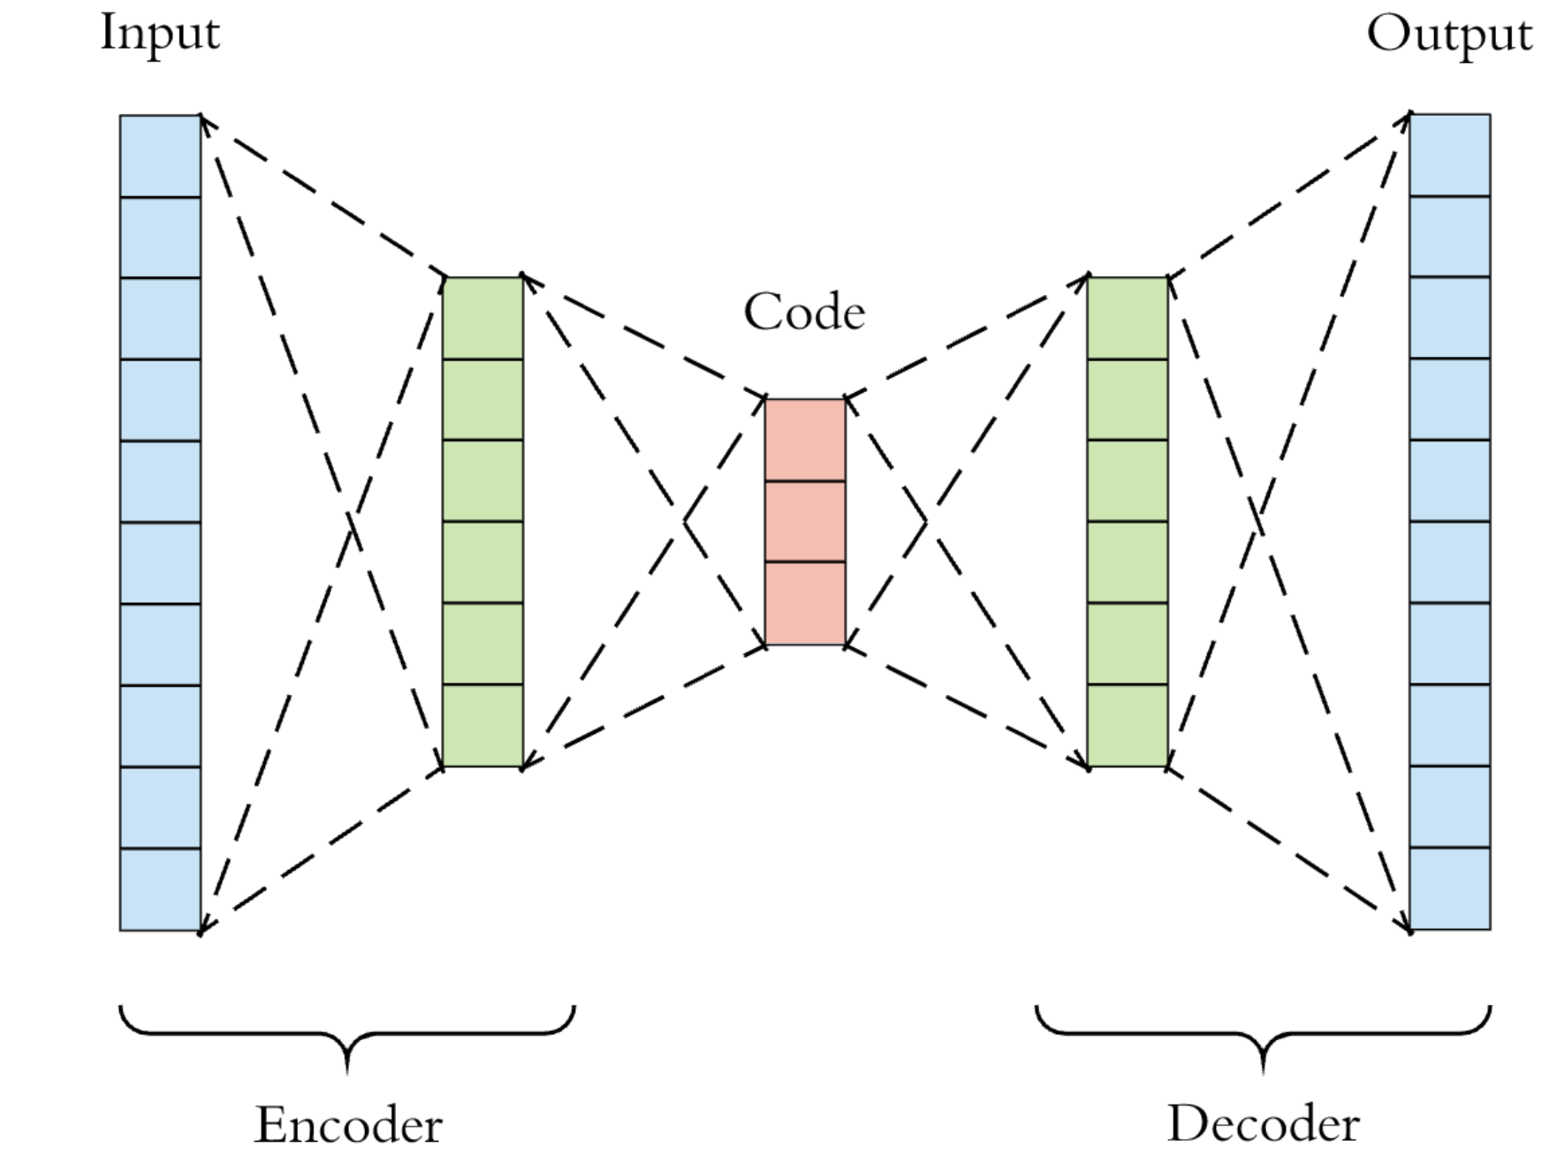
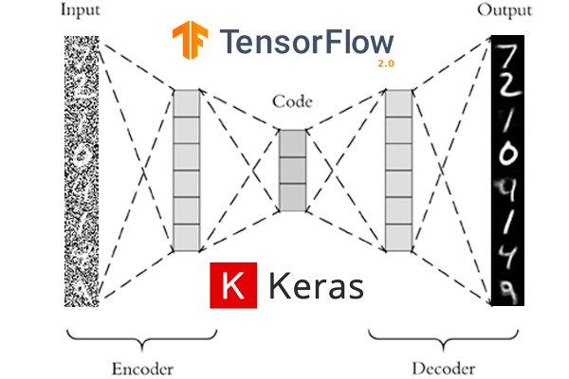
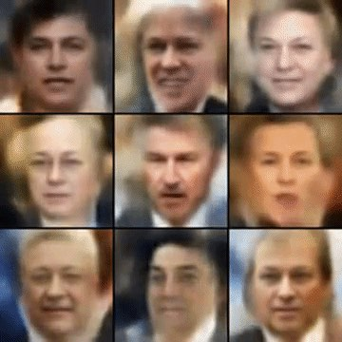
Autoencoding

